Slide 1
All your graphs are belong to us.
Nick Juliano

Slide 2
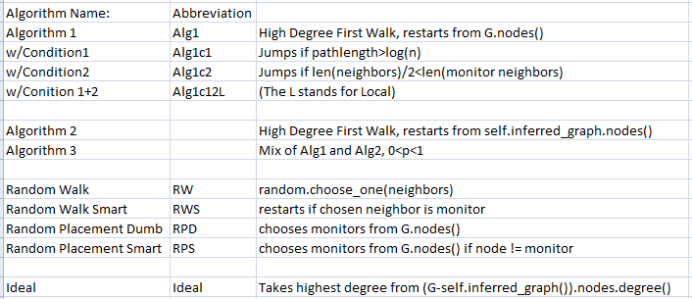
All the Algorithms

Slide 3
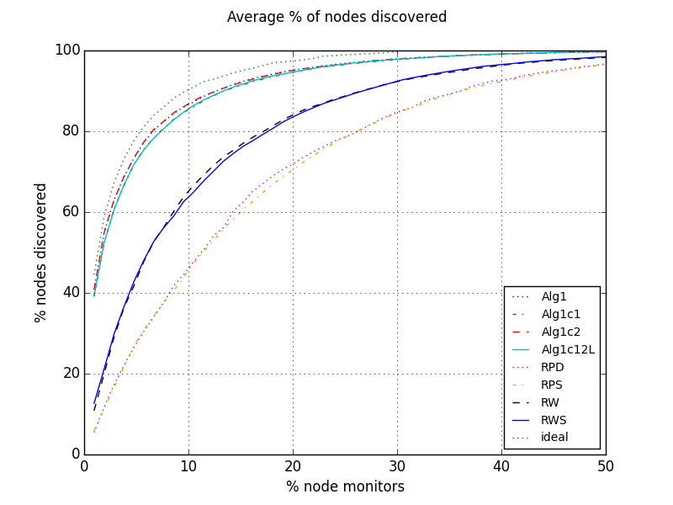
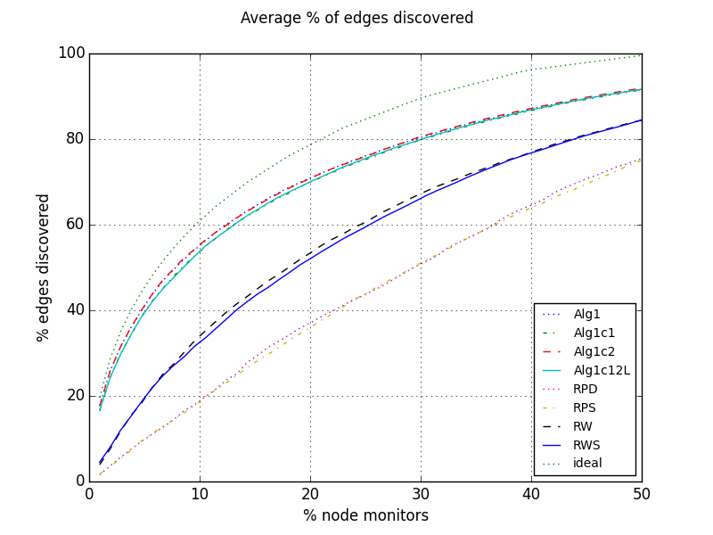
Barabassi-Albert
Nodes
Edges

Slide 4
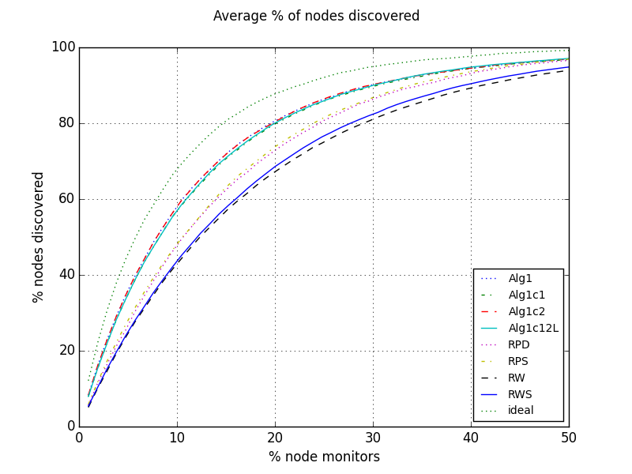
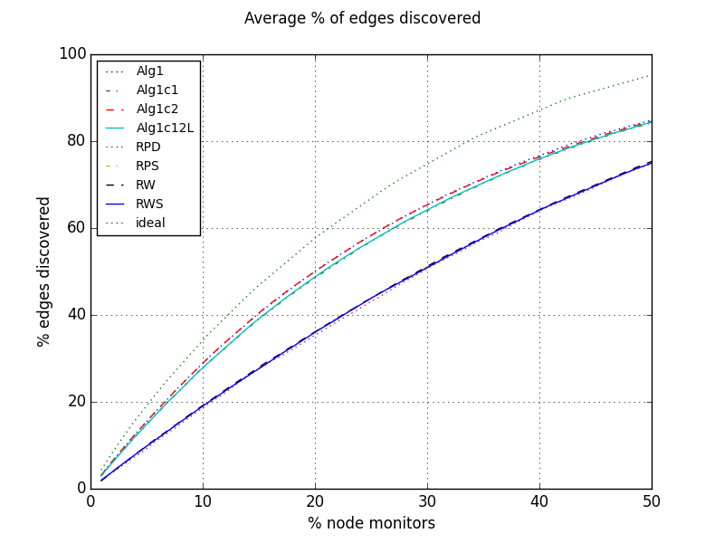
Erdos-Renyi
Nodes
Edges

Slide 5
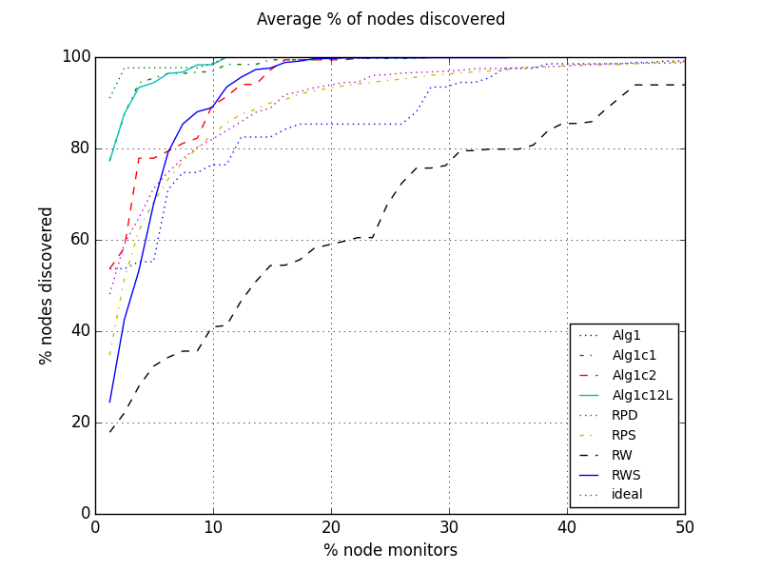
Facebook
Nodes
Edges

Slide 6
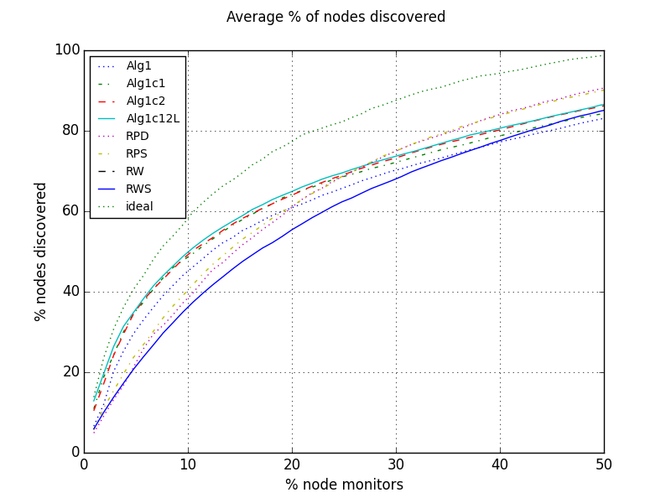
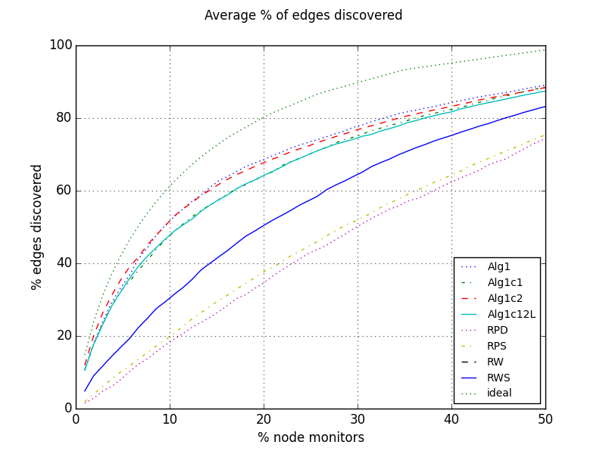
General Relativity
Nodes
Edges

